Slide 1
Tourism Simplified Through Voice
B,Tech (4th Year)
Major Project
Prepared by :
Sanskar Mittal
Shyamendra Bhadauria
Divyansh Kathait
Shivank
Under Guidance :
Mr. Vivek Mishra
(Assistant Professor)

Slide 2
Introduction
Over the past decade, there has been a huge shift towards conversational interfaces. Consumer attraction towards voice devices and assistants are already in place. To combat screen fatigue, voice assistants have entered market to become a preferred option for quickly retrieving information. Today a lot of customer is using voice assistance like Alexa, Siri, Google assistance, etc. There’s no denying that voice is the future. Since this is new technology various customer does not find what they require. A new skill adds more capability to this voice assistance and also attracts more customers to use that device.

Slide 3
Purpose of This Project
The main purpose of this project is to solve the pinpoint of tourists travelling in India. Tourists find it difficult to find any reliable guides which can solve their issue. This Alexa skill can be used by tourist to collect various information about heritage/tourist spots in INDIA. This skill answers various queries like what is special about the place, best time to visit the place. This skill can also be helpful for physically challenged people, as this skill recommends tourist places for physically challenged people.

Slide 4
Problem and Solution
The main question of this Project is, how efficient is an automatic voice system in the tourism area to offer practical uses to different peoples categories?
Our proposed solution involves building an Alexa skill with a focus on ease of access a nd providing contextual information and a companion skill for the tourists using which they can interact to get navigational records of the historical sites and associated promotional information, additionally we also intend to apply a multimodal experience approach to our conversational interface

Slide 5
problem to solution for sos hahaha nhi bn rhi bhai
For emergency support & SOS features, whenever any tourist requires any emergency support the skill will send alert messages along with his/her GPS coordinates by SMS, Phone calls and email to pre-set contacts asking for help.
The skill would keep statics about the number of users referring to the historical site along with user detail.

Slide 6






SOFTWARE REQUIREMENT
5.2.1 Programming Languages:
Python
Node Js
5.2.2 Services Used:
Alexa Skill Kit
AWS Lambda
AWS API Gateway
MySQL RDB instance

Slide 7
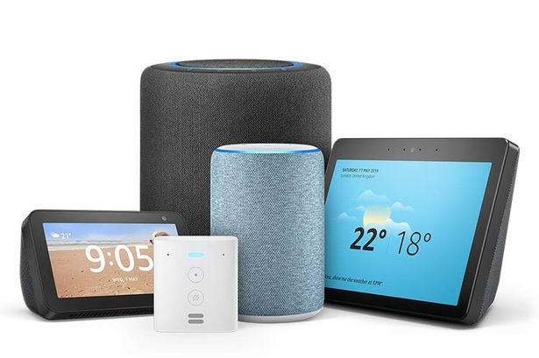
HARDWARE REQUIREMENT:
AmazonEcho and/or Alexa enabled devices

Slide 8
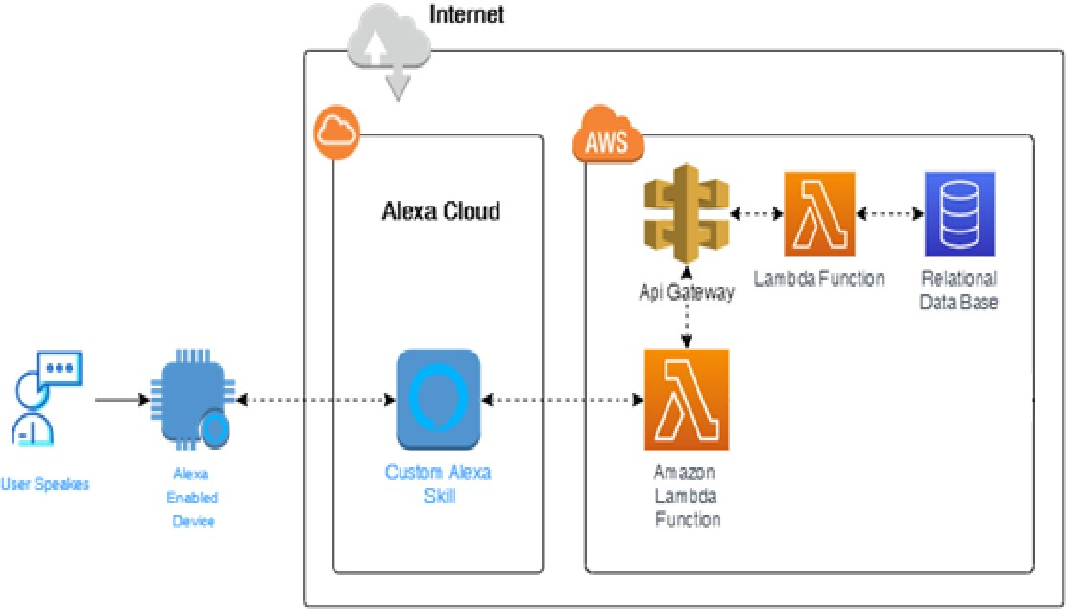
Proposed Architecture

Slide 9
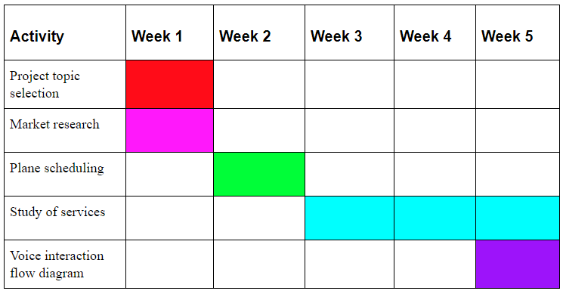
Gantt Chart

Slide 10
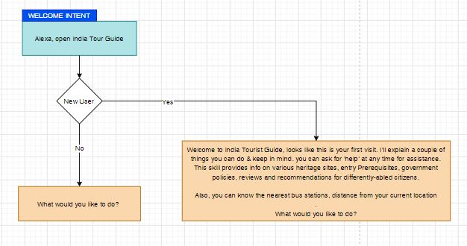
Voice Interaction FlowChart

Slide 11
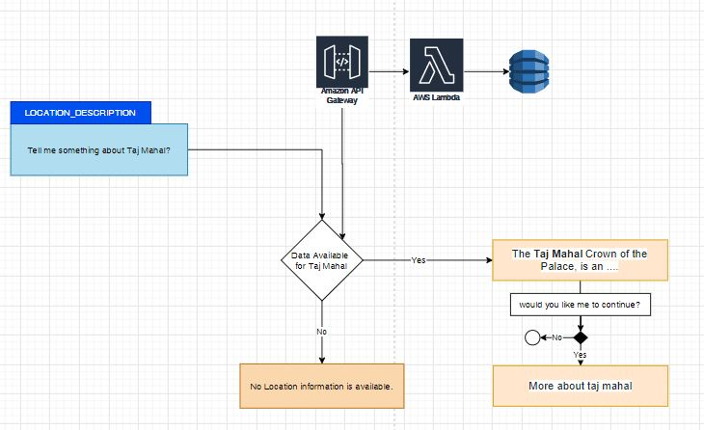
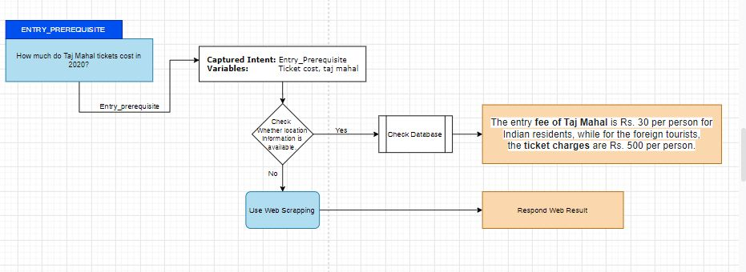

Slide 12
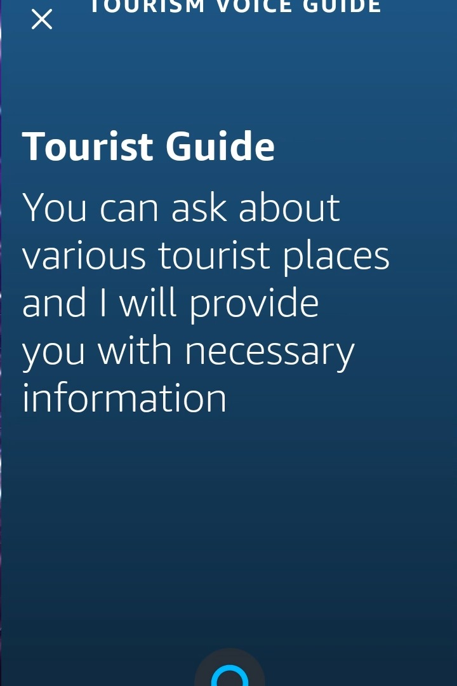

WORKING OF PROJEST

Slide 13
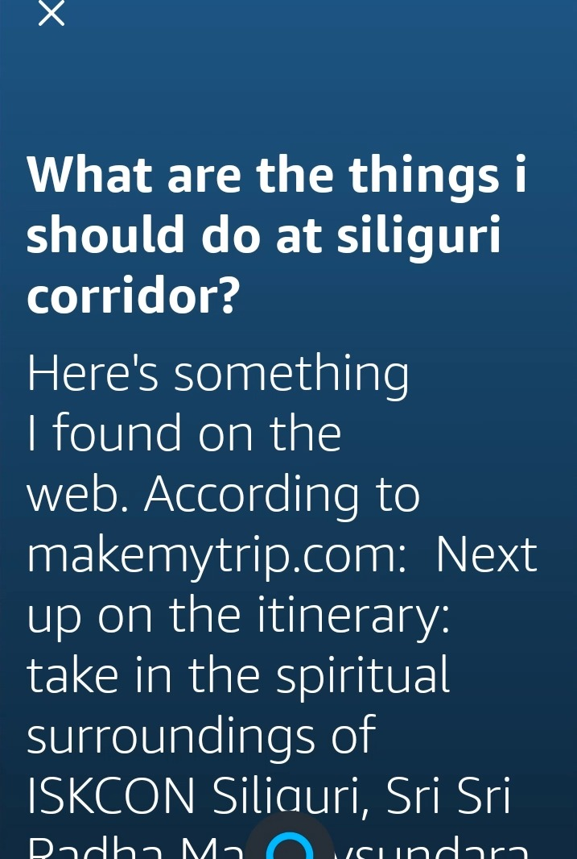
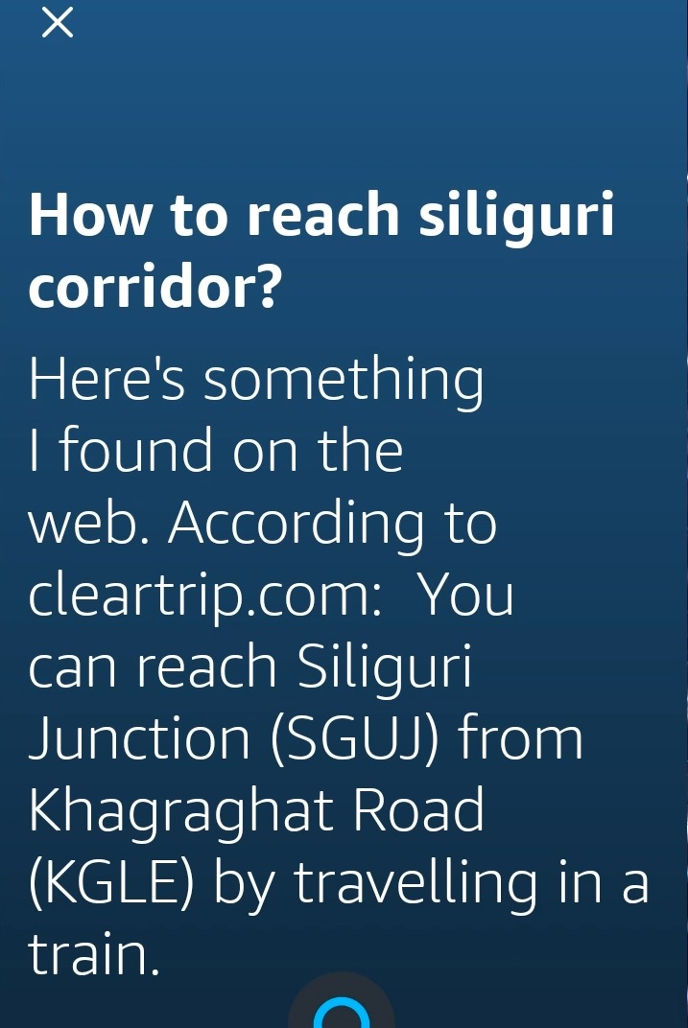

Slide 14
Action Plan
using voice flow diagram we have to develop Alexa skill.
We have to create a back end using python .We have to make Alexa able to interact with AWS lambda service.
We have to decide support database whether it is mysql or AWS paid database service.
We have to make database able to interact with the front end.
We have to create a portal where user can interact with the database and also fill the details of location.

Slide 15
Roles & Responsibilities
Enrollment Number | Name of Student | Responsibilities
41418002716 | Shyamendra Bhadauria | AWS Developer
41618002716 | Sanskar Mittal | Alexa Skill Developer
01018002716 | Divyansh Kathait | Python Programmer
40718002716 | Shivank | Database Administrator

Slide 16
Outcome of the Project
We successfully developed the voice application with all the defined requirements.
This have many Salient Features
Reliable
Trustful
Multimodal Experience
Elegant User Experience
Works on almost all of the Alexa enabled device

Slide 17
Thank You

